Slide 1
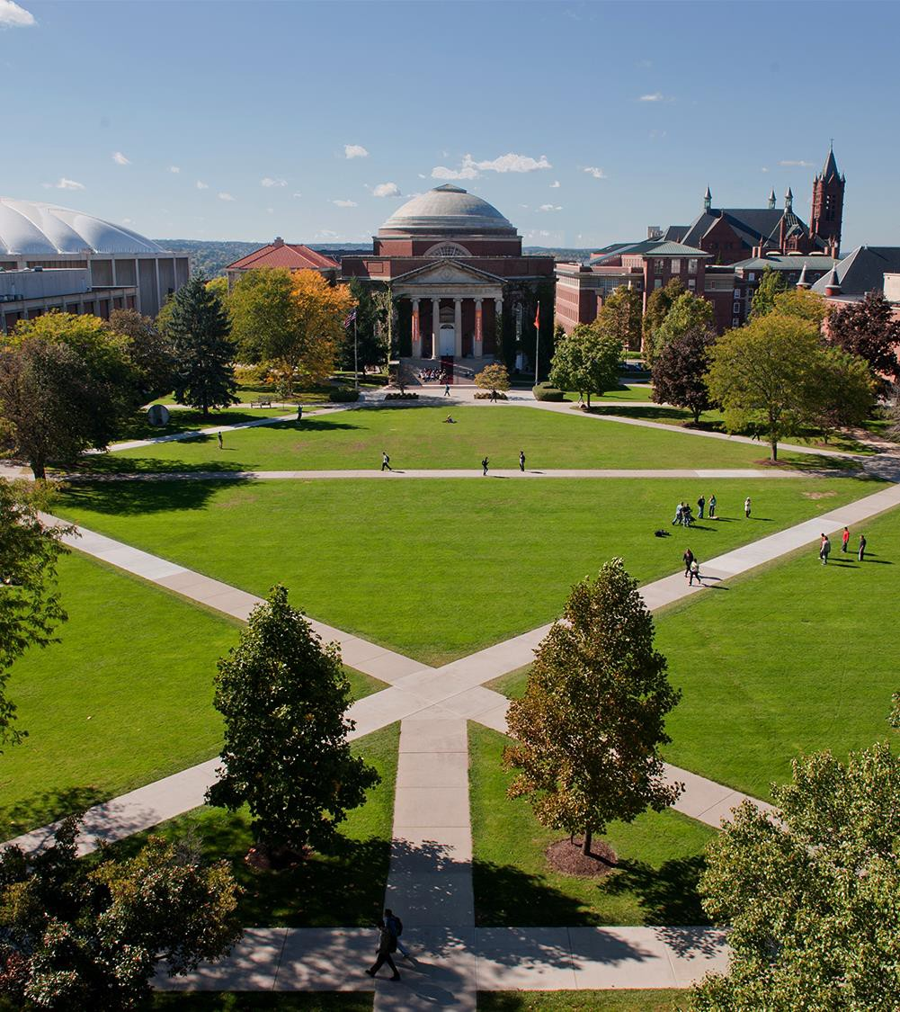


Annie Titus
MILESTONE PORTFOLIO PRESENTATION
APPLIED DATA SCIENCE
March 18, 2022

Slide 2
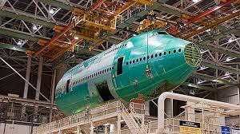


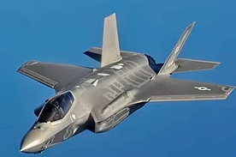
Introduction—Who is Annie Titus?
I received my bachelors degree from the University of Colorado- Boulder for Business Administration with an emphasis in Finance. From there, I developed an interest in Project Management and enrolled in the PMP certification program at Southern Methodist University in Dallas, TX.
My current profession is in the Aerospace Industry working daily on projects that involved complex dataset, while following a structure project methodology. Beginning 2020, Data Science sparked my interest and by Oct 2020, I enrolled in the ADS program at Syracuse.
2

Slide 3
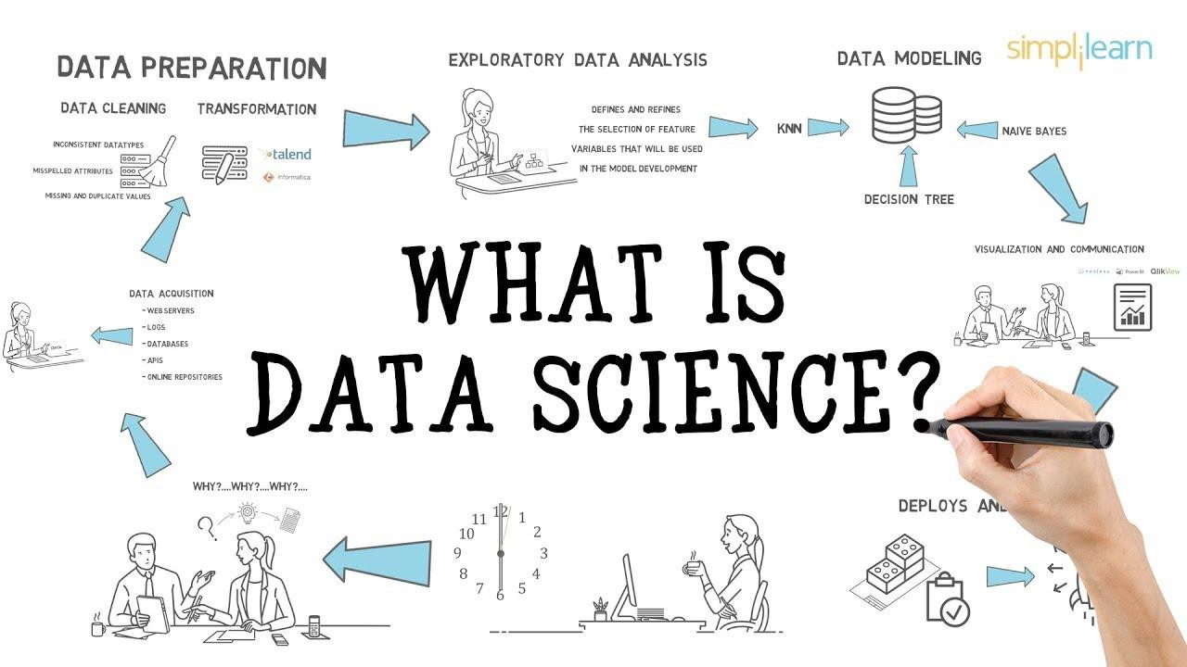
What is Data science?
TAKEAWAY:
Data science is a problem-solving process
The process consists of
Data Acquistion – gather data from relevant sources
Data Exploration – include data cleaning and finding significant patterns and trends using statistical methods
Analytic -– construct model to predict and forecast
Interpret – report results with evidence, put the results into good use
In the following, I will talk about each of these process, and the project that i have done in the program that best illustrate this process
3

Slide 4
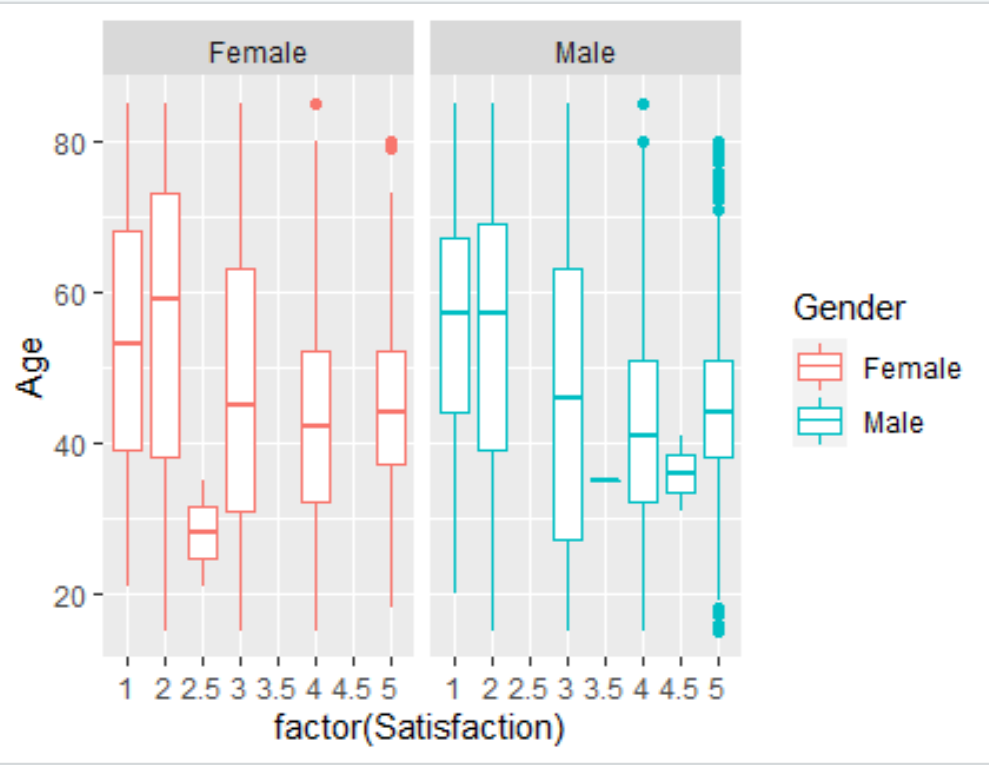
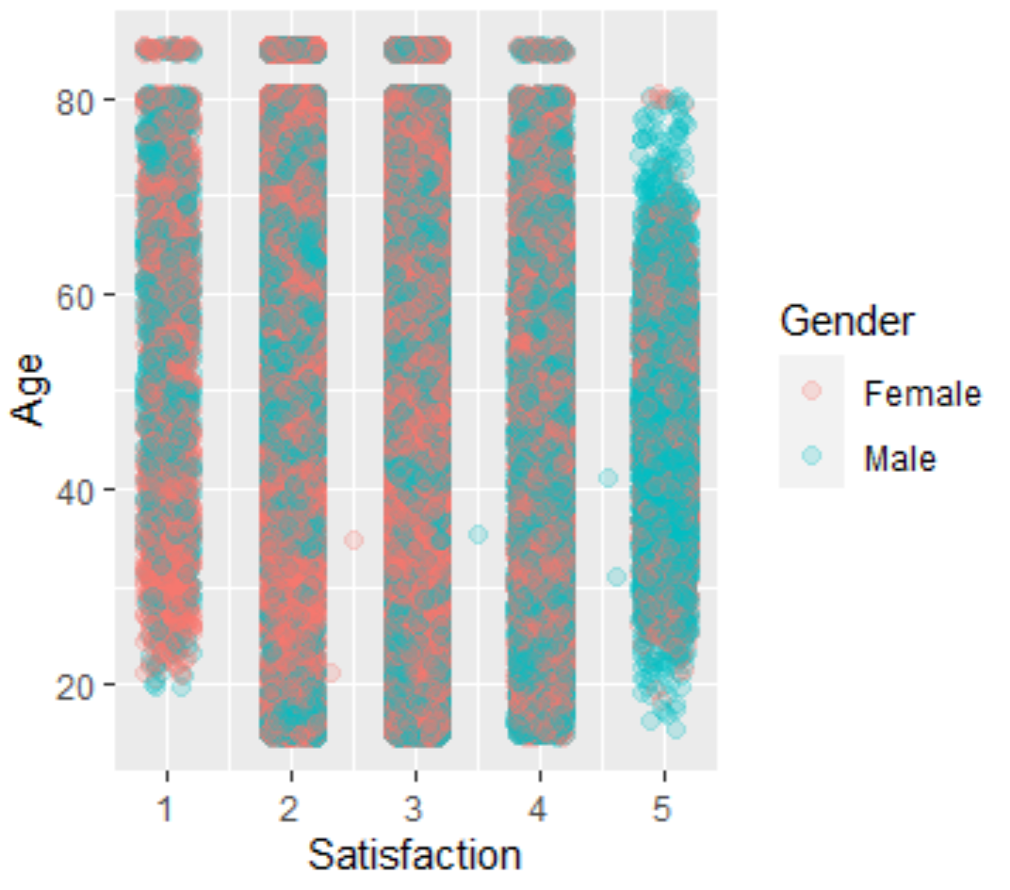
Project Based learning-Airline Satisfaction Data
The objective was to analyze an airline dataset that consisted of responses from surveys of customers flying within the United States. The goal to identify visible trends and patterns in predicting customers with low satisfactions compare to those with high satisfaction(1-5). Through this prediction, provide actionable insight that would improve future customer satisfaction results and in turn help increase airline profits.
Business Questions included:
Is there an attribute that correlate to higher satisfaction or lower satisfaction score?
Is there a correlation between time spent at airport to satisfaction ranking?
What airlines are performing well/poorly?
Does the demographic group differ between levels of satisfaction? What are their demographics?
Observation: Strong correlation between Age, Gender, and Satisfaction showing males between 20-60 years old very satisfied and older male and female age 60-80 not very satisfied
4

Slide 5
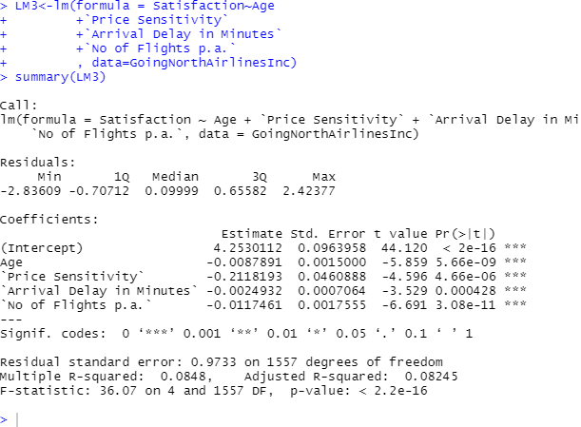
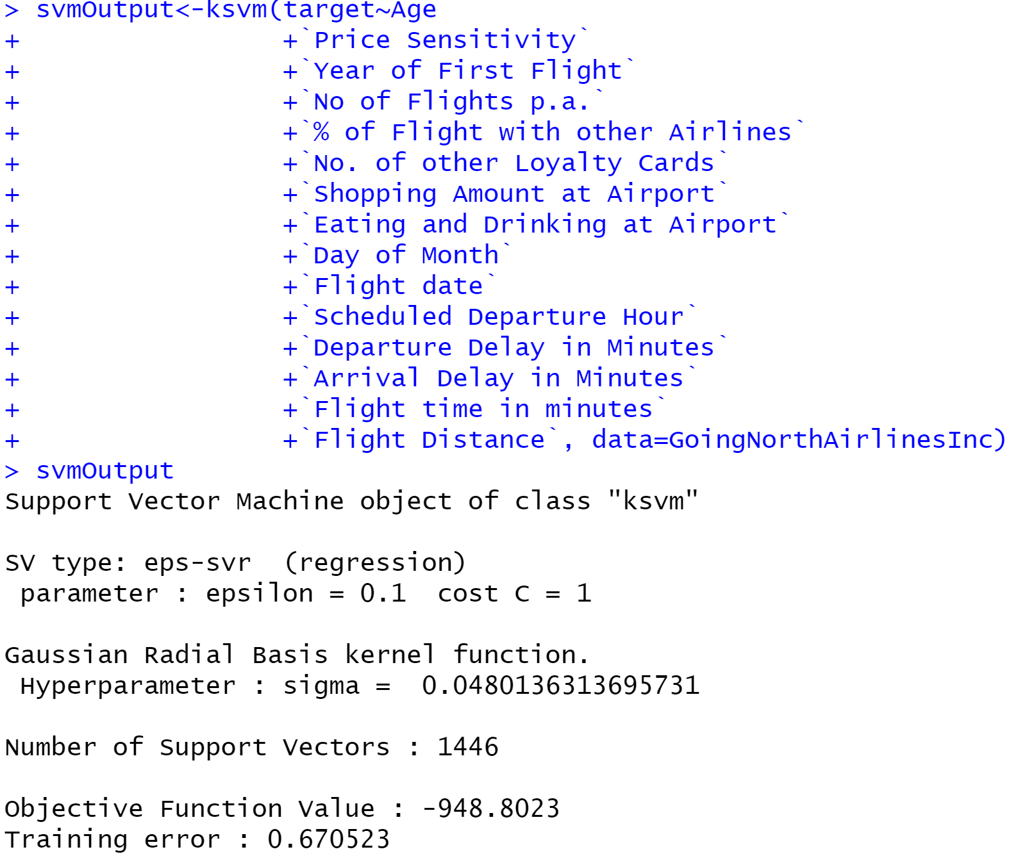
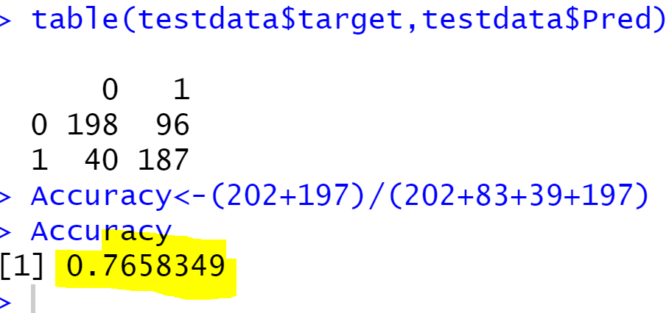
Project Based learning-Airline Satisfaction Data (cont.)
1st Model – Linear Model Regression to see statistically significant variabless
2nd Model – Support Vector Machines, using KSVM function
4

Slide 6
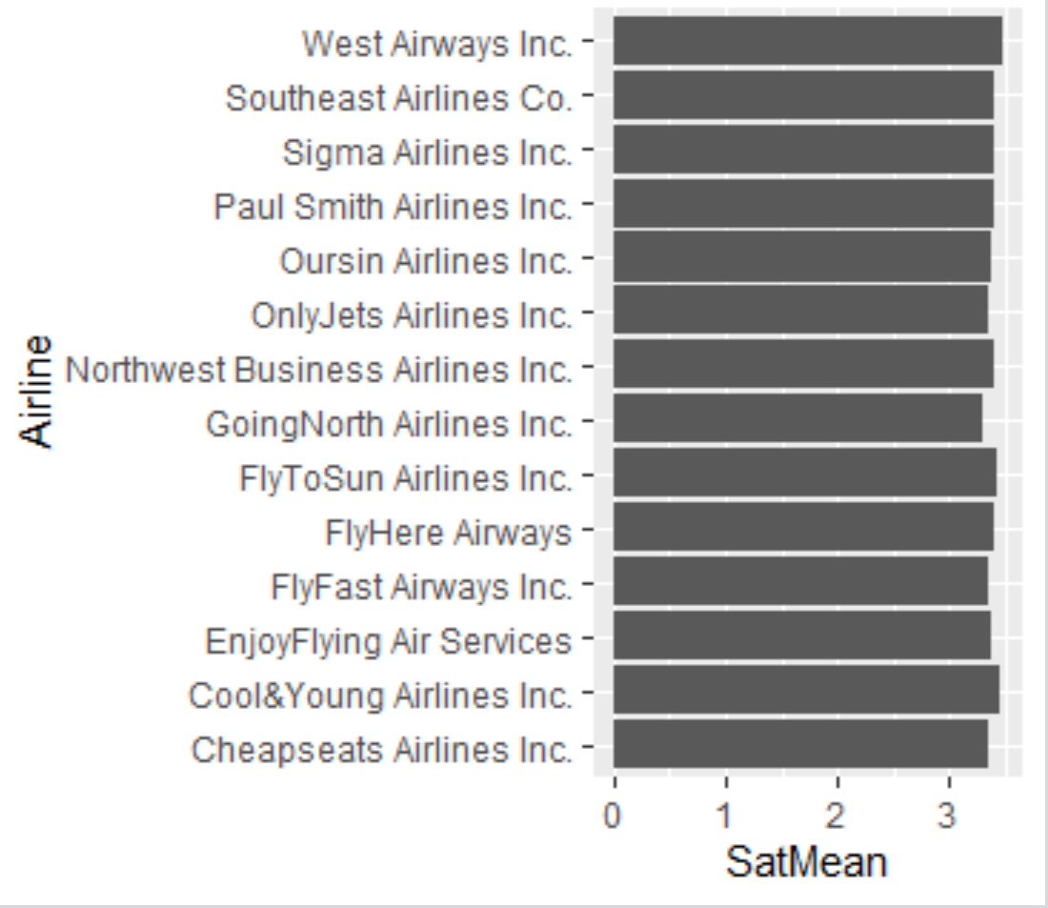
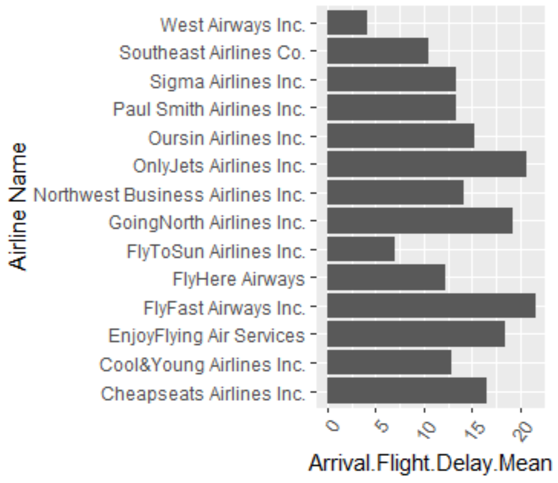
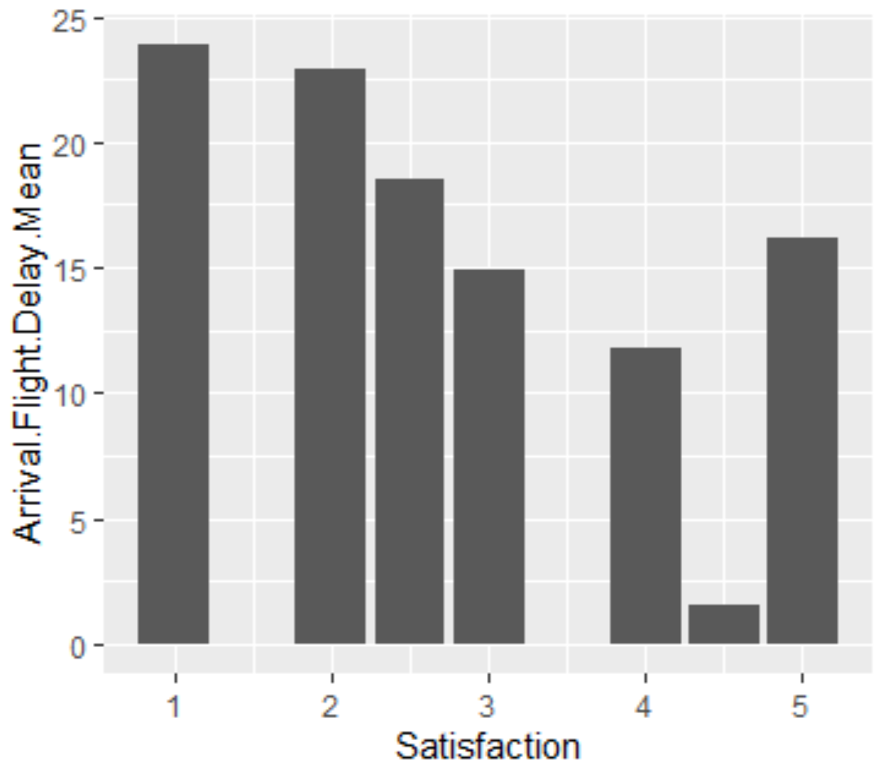
Project Based learning-Airline Satisfaction Data (cont.)
FINDINGS AND RECOMMENDATION
Focus on males between the age of 20-60, as they are their satisfied customers. If Airlines are wanting to reach further, they should expand the demographic to reach the female population of age 20-60
Be very conscious of their flight prices as price sensitive customers tend to give lower satisfaction, especially paired with flight delays
Airlines should work to keep the average Arrival Delay less than 20 minutes since lower satisfaction is correlated to higher arrival delay
When considering which terminals to reside in, airlines should be conscious of the bars and restaurants in the terminals that appeals to their demographic customers, since Eating and Drinking at Airport shows to be a significant variable to satisfaction
4

Slide 7
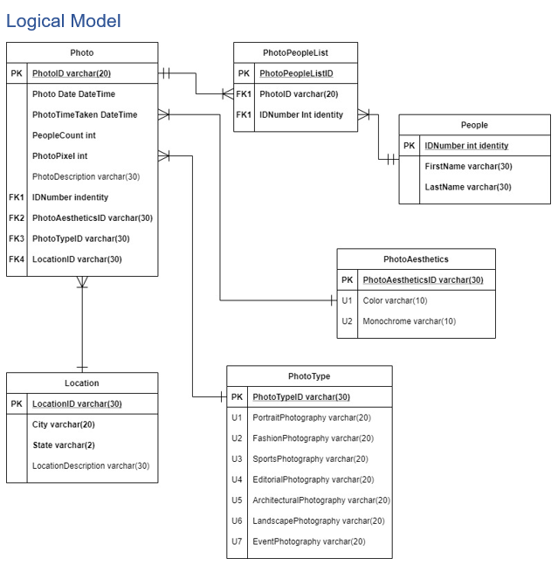
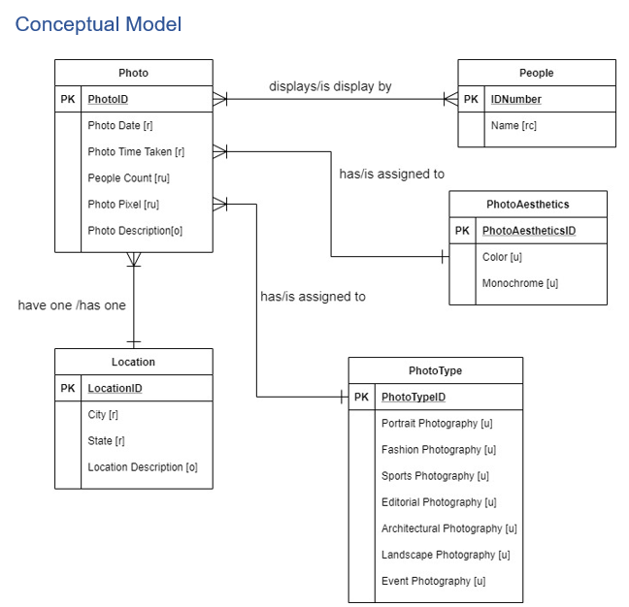
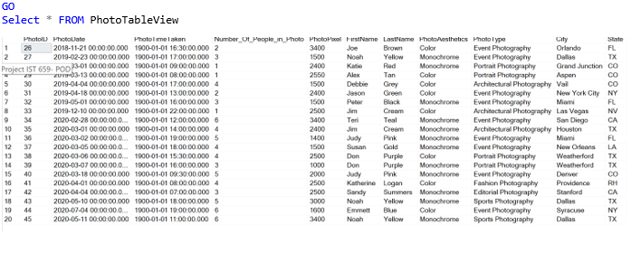

Project Based learning-Photo Organization Database
Have you ever gotten the notifications on your icloud that said, “Storage Almost Full” or “Not Enough Storage available for back-up.” I get these notification pop ups daily on my cloud or on my phone, and when I look to see what is taking up my storage space, it’s always my photos. This project looks at the implementation of a photo organization database (POD), to help streamline my photographs
Observation: Most photos were taken in the months of March and April, signaling that are months are busier times for the photographer
5

Slide 8

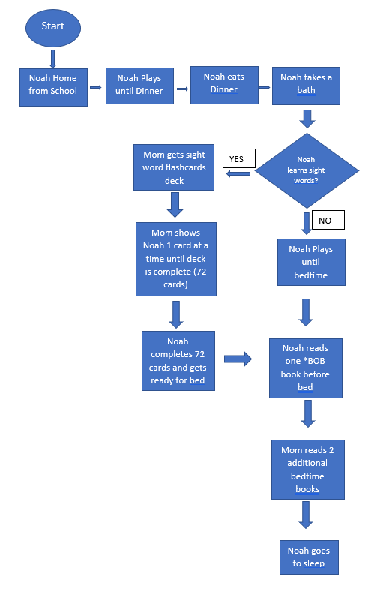
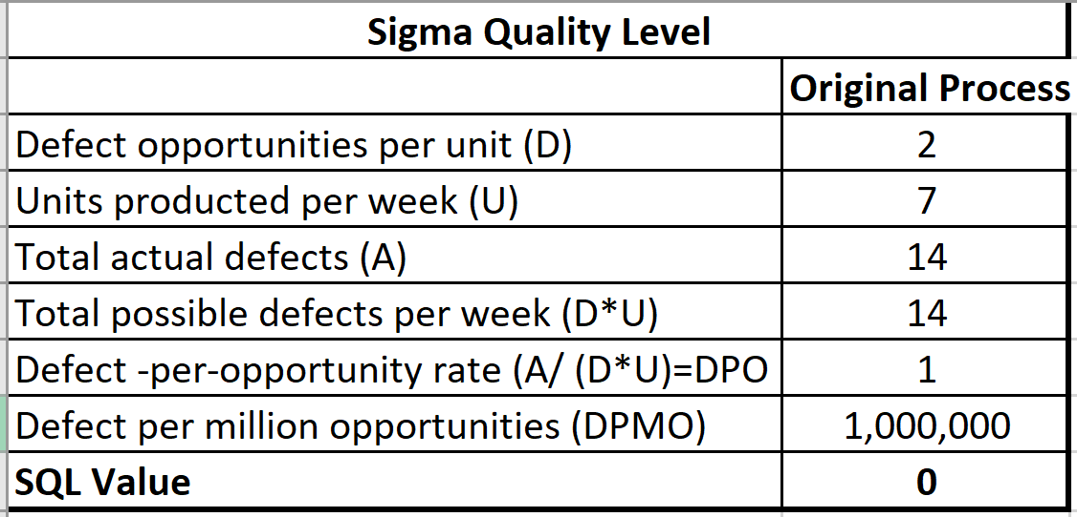
Project Based learning-Increase Sight Word Recognition
PROBLEM STATEMENT
Most children began learning sight word recognition at the age of 4, and on average should know as least 10-12 words by age 5. My son, Noah turning be 5 in Feb 2021, and know 8 sights words from a deck of 72-word flashcards. Due to lack of sight word recognition, Noah has been identified on his kindergarten readiness test as “needing to know more sight words”
Original Process Flow
POSSIBLE ROOT CAUSE:
Timing in the evening
Incentive
Learning method
The Original Process, with an SQL =0
GOAL
Increase the number of sight word count Noah recognizes. Noah has a flashcard deck of 72 sight words. The goal is for him to recognize at least ½ of the cards, 36 sight words which will be a 39% improvement from his existing 11% sight word recognition
To identifies ways of learning sight words that Noah enjoys, and will help continue to increase his word count
6

Slide 9
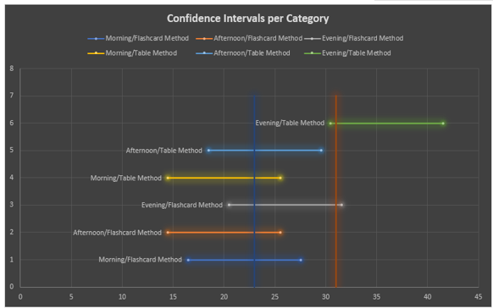
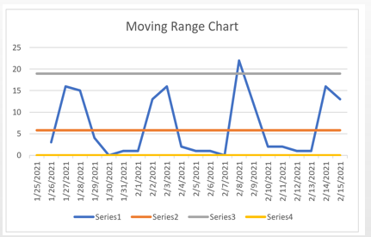
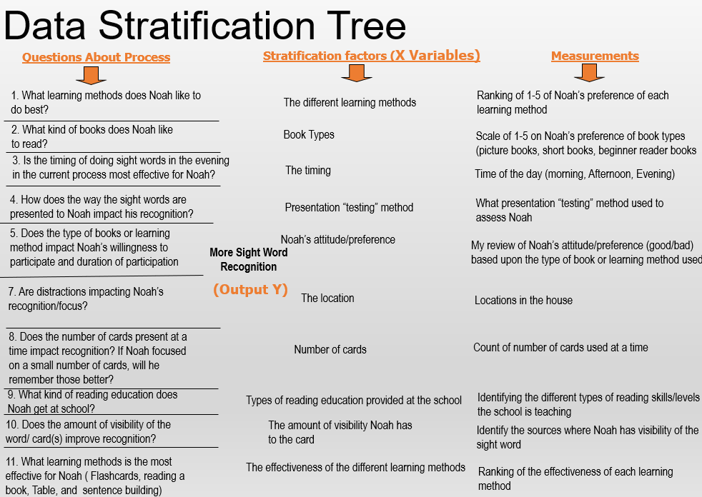
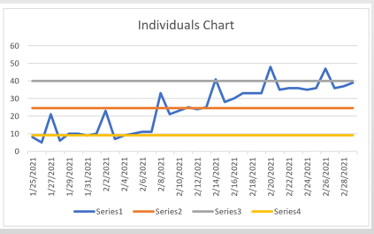
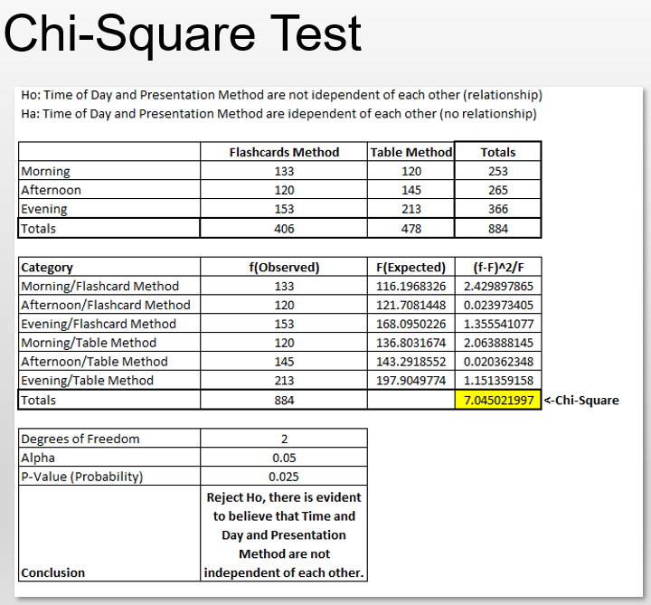
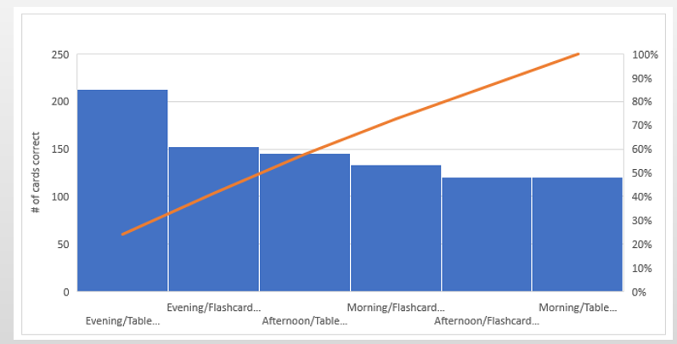
Project Based learning- Increase Sight Word Recognition(cont)
ANALYSIS COMPLETE
7

Slide 10
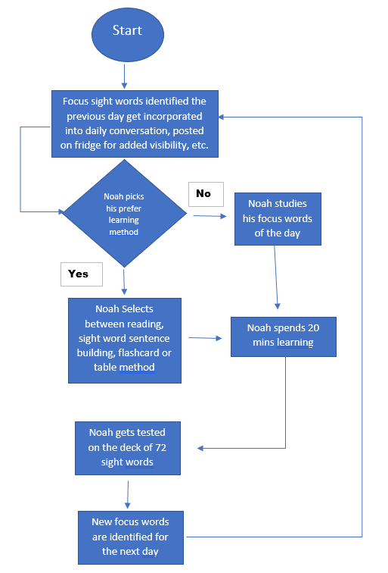

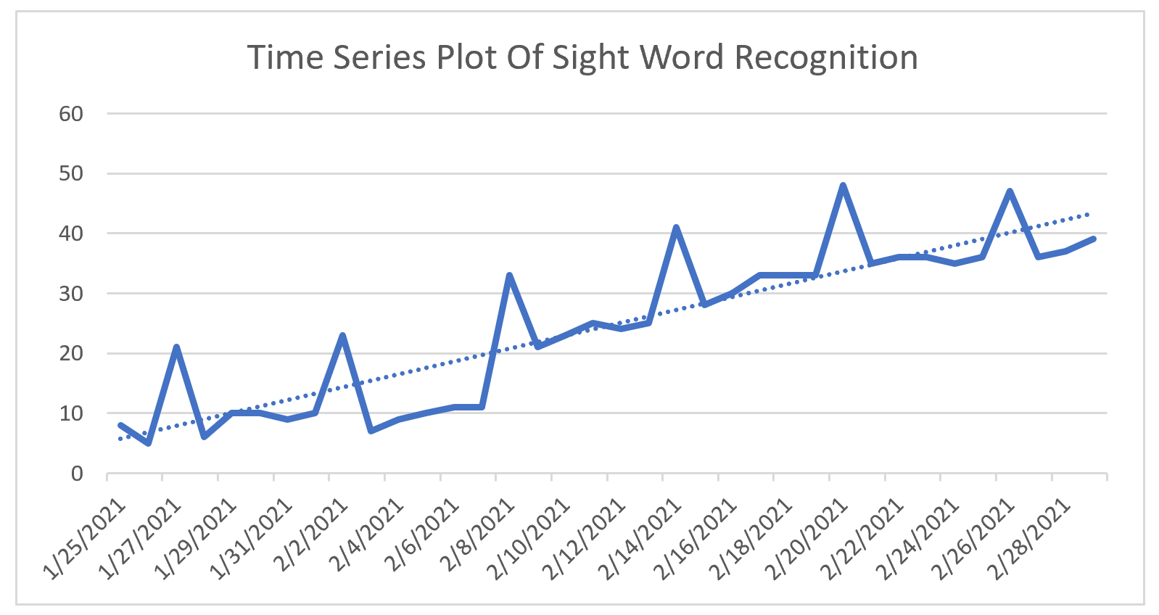
Project Based Increase Sight Word Recognition(cont.)
FINDINGS AND RECOMMENDATION
NEW Process Flow
New SQL improved to 2.3!
Continue visibility and other different methods of learning, to encourage progress in the learning
Root Cause found
Not enough freedom of choice and choices for method of learning
Time of day of exposure learning
Apply above steps to forecasted periods to confirm Sight Word improvements
A regression formula can be used predict how well Noah will do in the future.
8

Slide 11
Project Based learning-HULU Original Feature Film
Perceptual Mapping between platforms and ratings
Netflix
Hulu is preparing to make feature films for their streaming services.
Our Goal:
Utilize a large dataset to identify predictors of highly rated movies using movie rating such as IMDB and Rotten Tomatoes
Use these ratings as predictors for various movie attributes (genre, age, rating, runtime, etc.) to determine if a film will be highly rated
This prediction will allow us to choose the specific attributes of our film and what (additional) platform(s) to stream it on
Marketing Question:
What are the movie attributes that are tied to a success movie rating?
HULU
Prime Video
Disney+
9

Slide 12
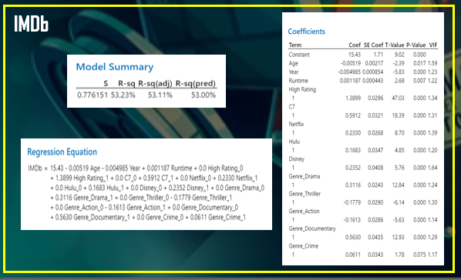
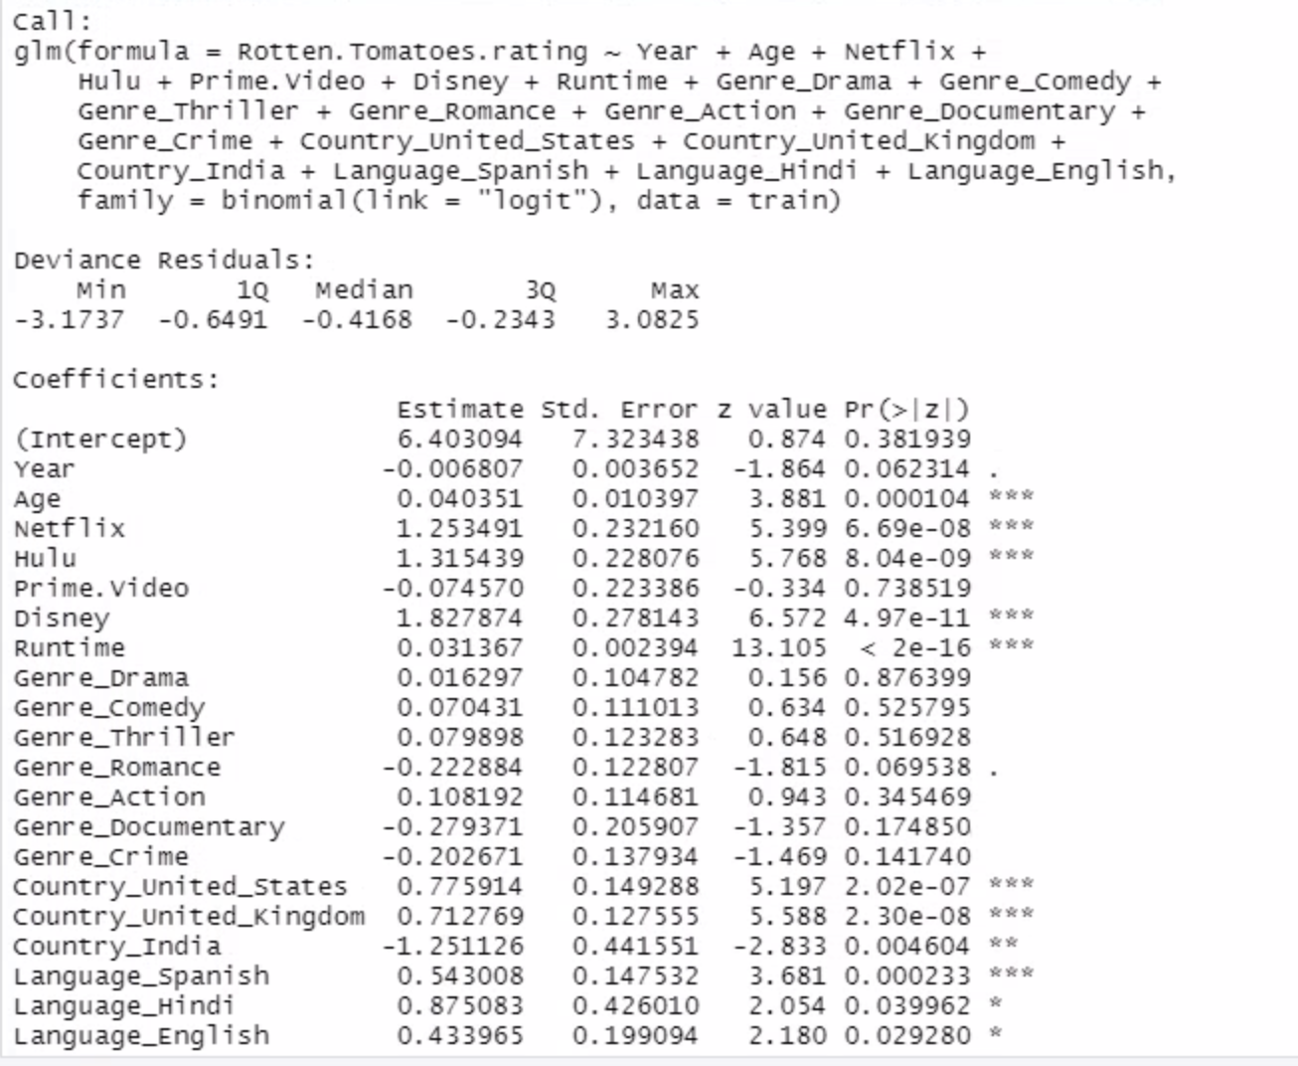
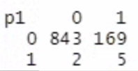
Project Based learning-HULU original Feature Film (cont.)
Linear Regression with the IMDb Ratings
Based on our results from the Perceptual Mapping and the Regression analysis, my final recommendation is…
Create a Drama, Thriller, Crime movie with a runtime of 170min and rated for 18+.
The Perceptual mapping shows that Hulu movies are mostly in the high IMBd rating and high Rotten Tomatoes rating
The linear regression model shows that the movie attributes on the right combine showed a significant R square which demonstrated that an movie created with these attributes can be predicted to have a 88% Rotten Tomatoes rating and/or an IMDb rating of 7.8.
The logistic regression model shows that dependent on which rating Hulu cares about more (IMDb vs Rotten Tomatoes), the movie criteria will change a bit. For example. Genre matters in Rotten tomatoes then in IMDb ratings per the logistic regression.
Logistic Regression on Rotten Tomatoes Ratings
9

Slide 13
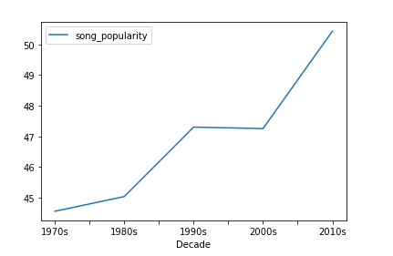
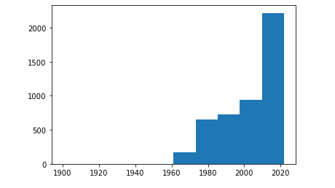
Project Based learning-PREDICTING SONG POPULARTIY
This project takes a look at the evolution of songs over the years and the ever-changing attributes associated to them
In this effort, the goal was to allow for artists to be able to accurately predict the popularity of a song through an analysis of the song attributes.
Observation: The average song popularity was steadily increasing between the 1970s -1990s before plateauing between the 1990 and 2000
Since then, it has been on the rise, increasing to 50.54% in the 2010s
10

Slide 14
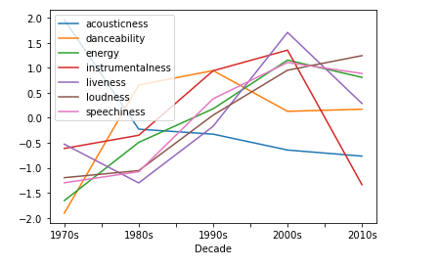
Project Based learning-PREDICTING SONG POPULARTIY
Observation:
Acousticness is the one attribute that has been on the decline throughout the decades
This is likely the result of electronic instruments becoming more prominent
Instrumentalness, Liveness, and Speechiness all increased over time before declining in the 2010s
Energy and Loudness have been heavily increasing over the years.
10

Slide 15
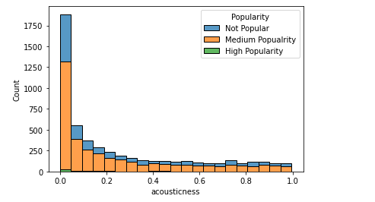
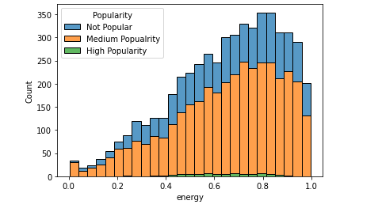
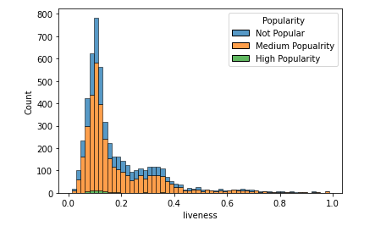
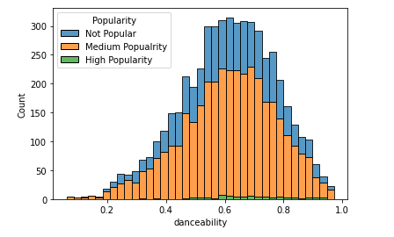
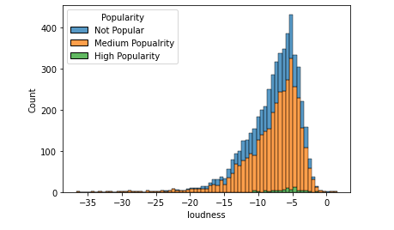
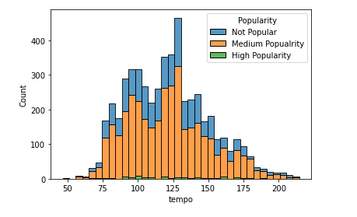
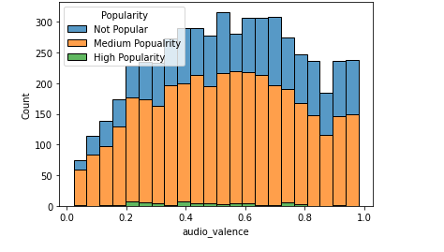
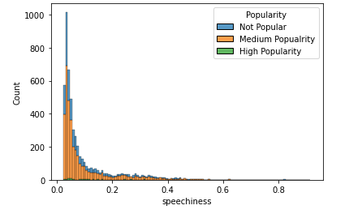
Project Based learning-PREDICTING SONG POPULARTIY
FINDINGS AND RECOMMENDATION
The result is an inside look when I look at popular songs and each attributes, there are common attributes to make a popular song such as low acousticness, high danceability, high energy, and tempo. These attributes give insight to the artists when creating the next big hit.
10

Slide 16
Thank you, Syracuse!
What is next?
15

